Slide 1
Team E
Groups 7 & 8

Slide 2
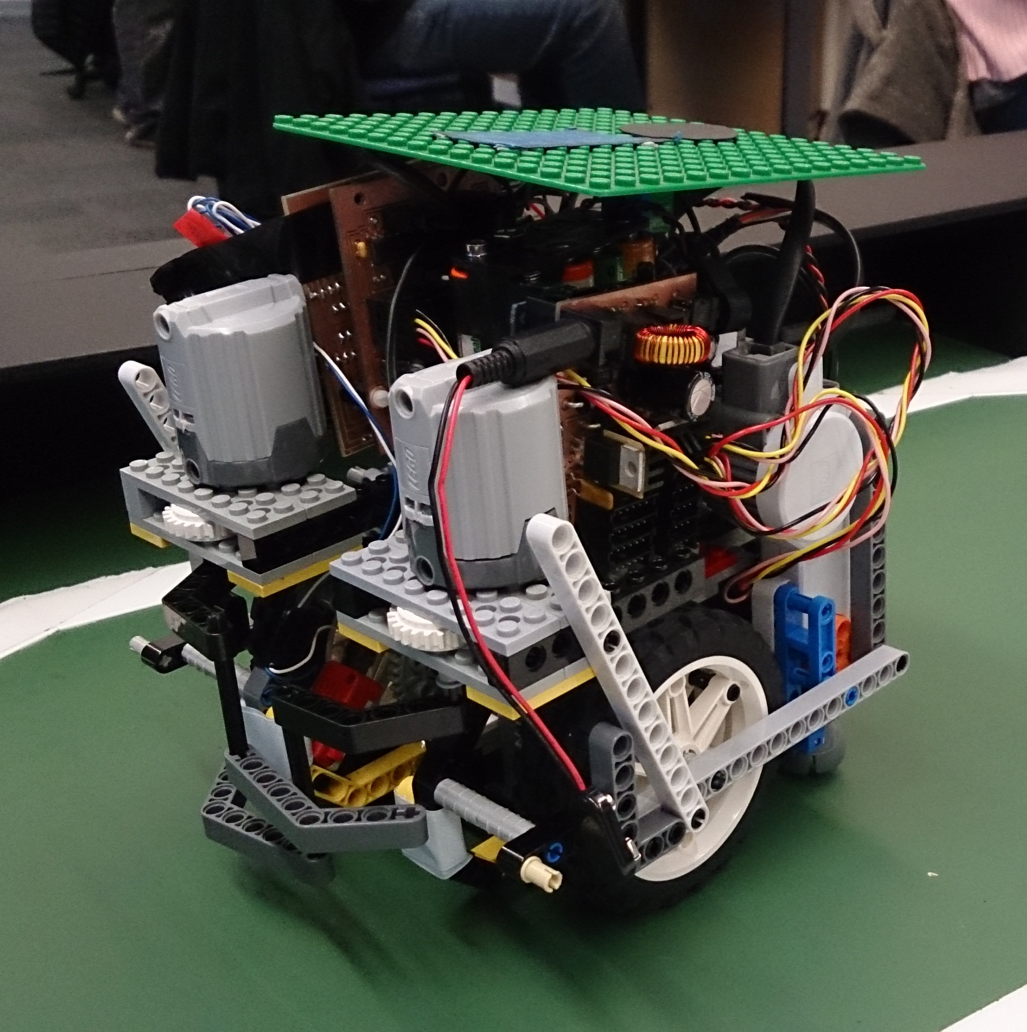
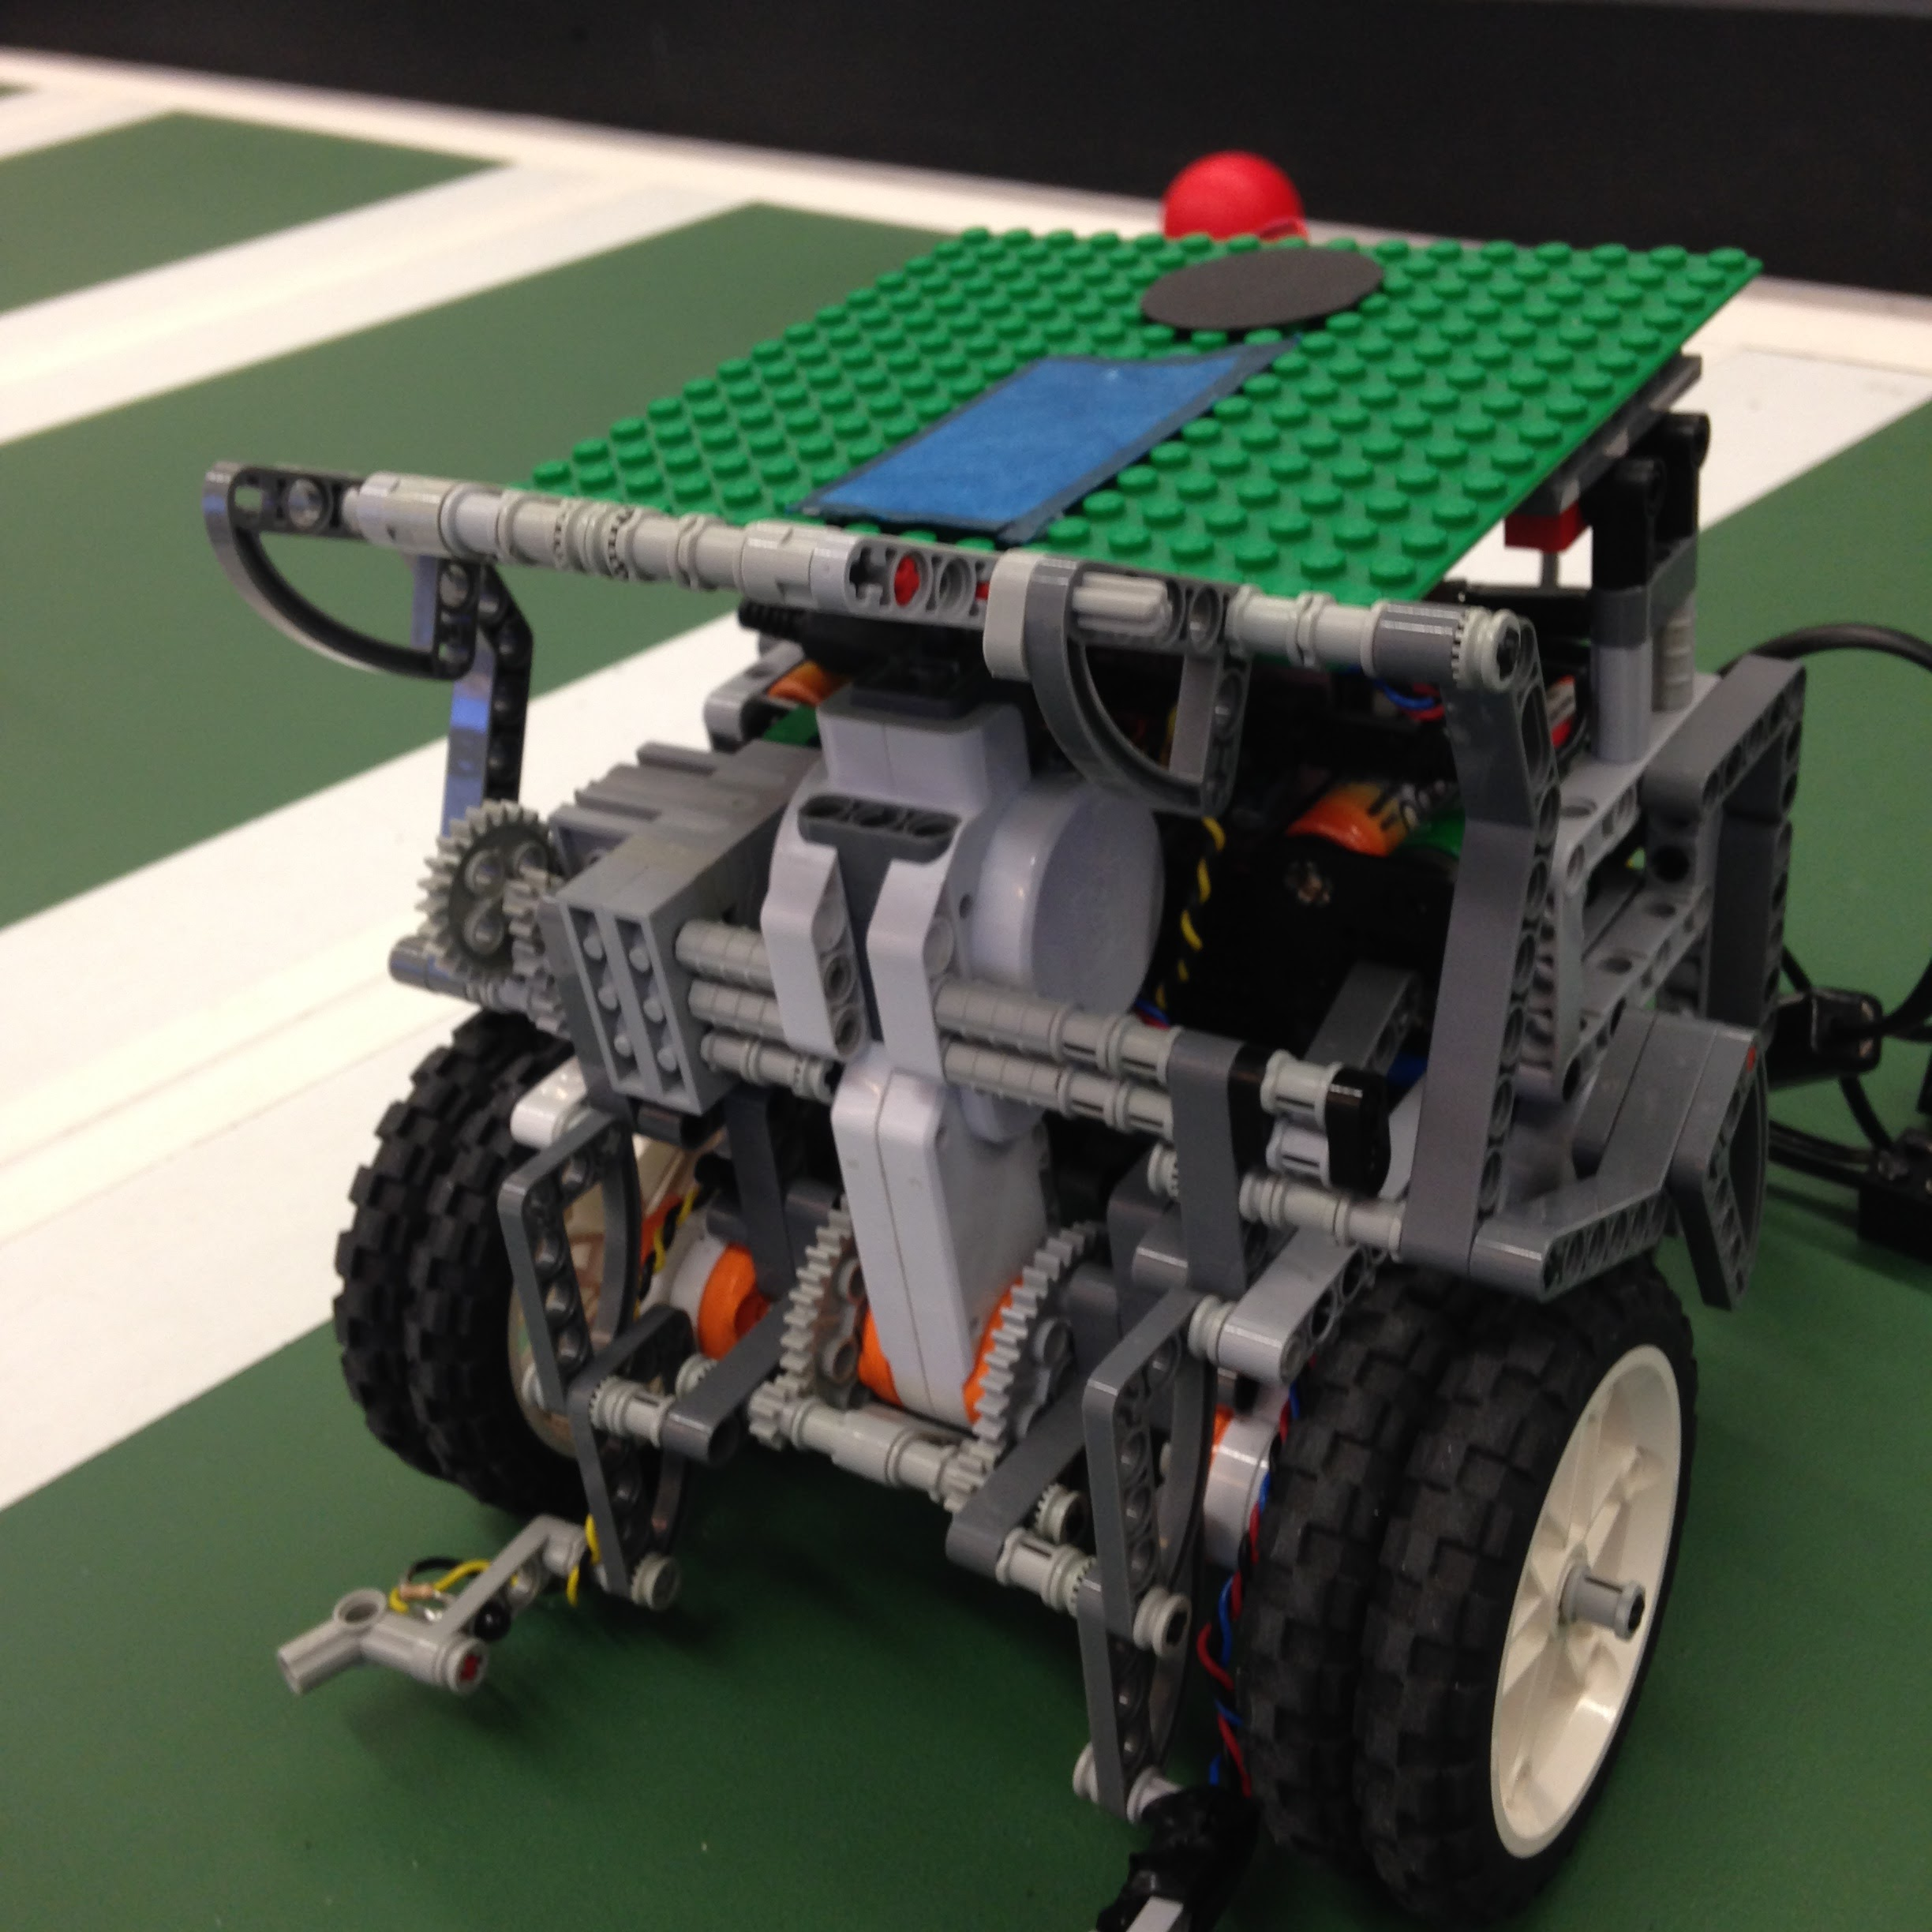
Pictures of Robots
Group 7 Robot
Group 8 Robot

Slide 3
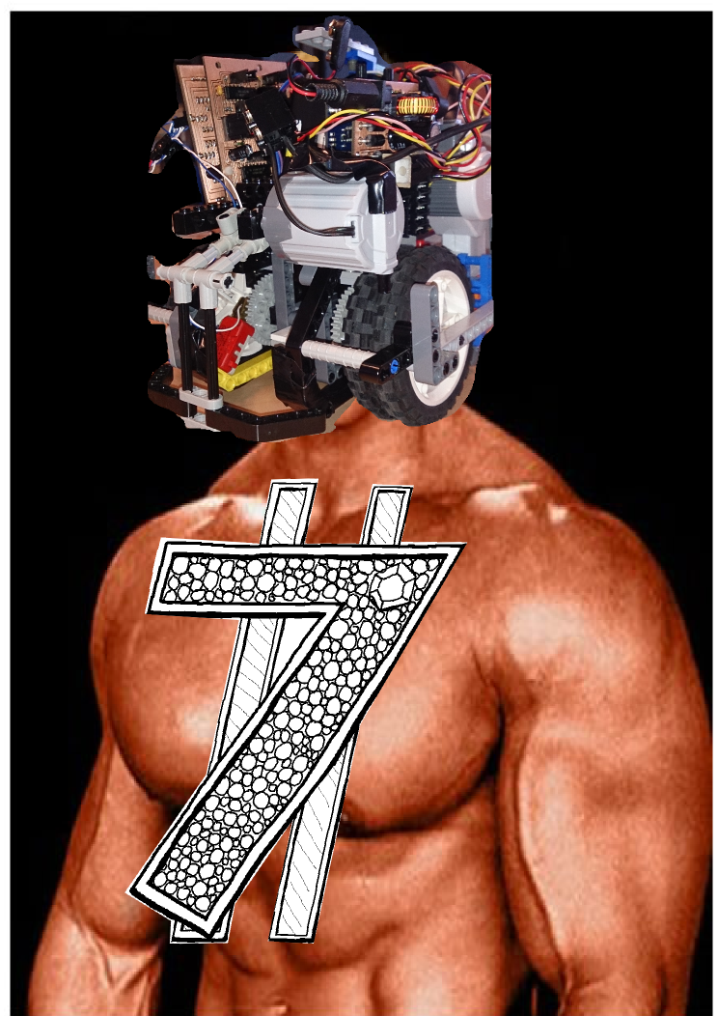
Group 7
Paul Scherer
Chris Seaton
Roy Hotrabhvanon
Yiheng Liang
Murray Crighton
Teun Kokke
“Margaret”

Slide 4
Group 7
Working as a group

Slide 5
Organisation and Management
Software + Hardware Lead roles to help organise work.
The code has been largely been ported over from Group 7 as suggested from the previous year, heavily refactored to match our language standards.
Issues were dealt with
Face to face meetings.
GitHub’s issue tracker.
Trello to keep track of work.
However… working as a group is hard

Slide 6
Group 7
Hardware

Slide 7
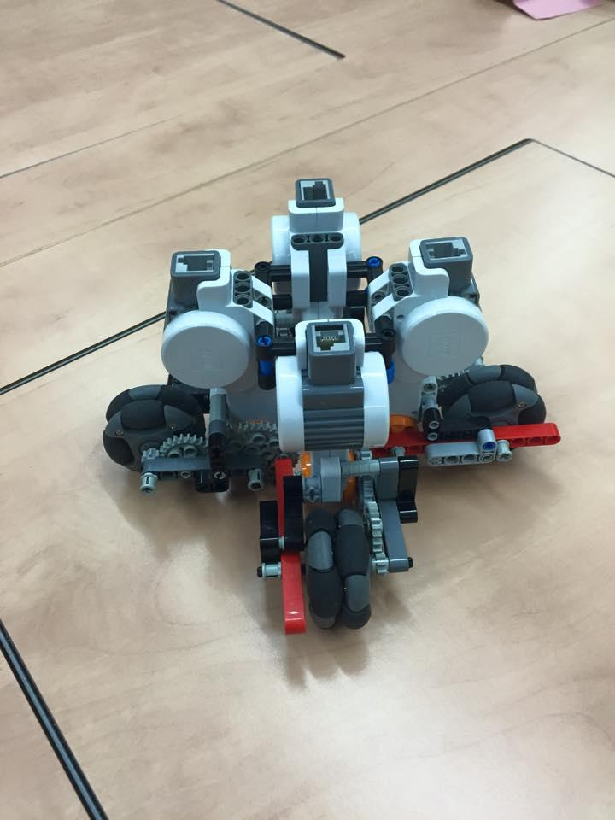
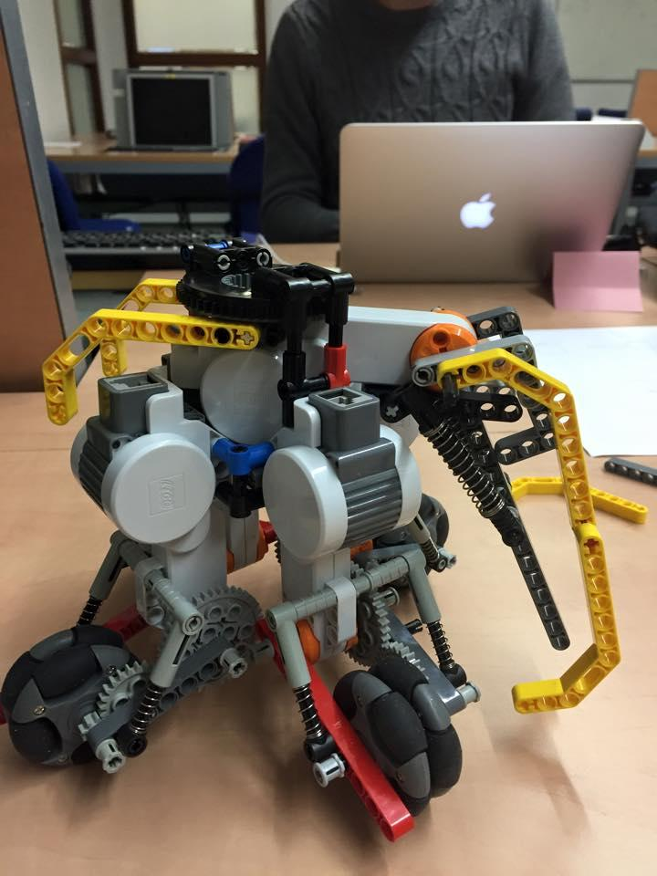
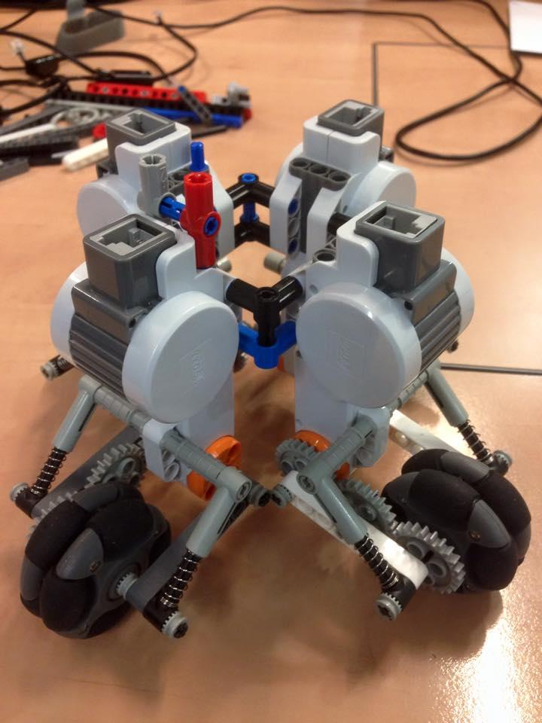
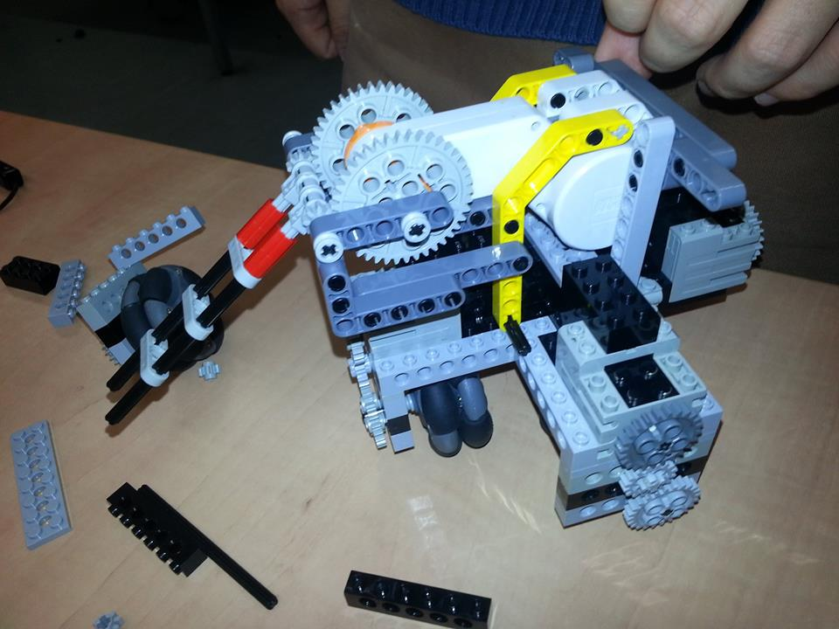
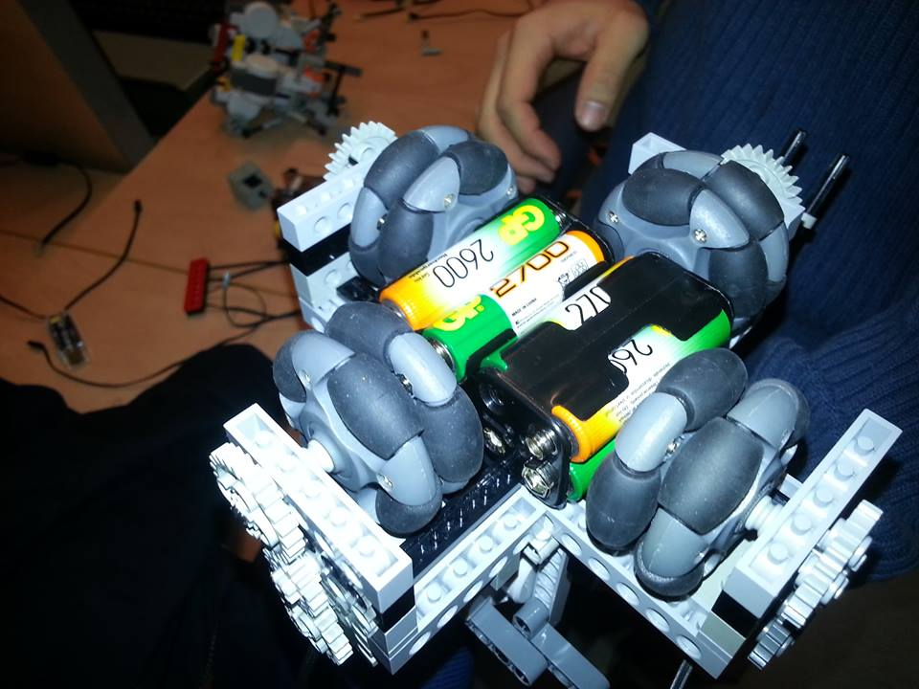
Fast
Omnidirectional movement capability
Too Tall
Too Wide
Slips (Unreliable Movement)
Weak Kicker
Difficult to program movement
Evolution of Margaret “Speed is King Era”

Slide 8
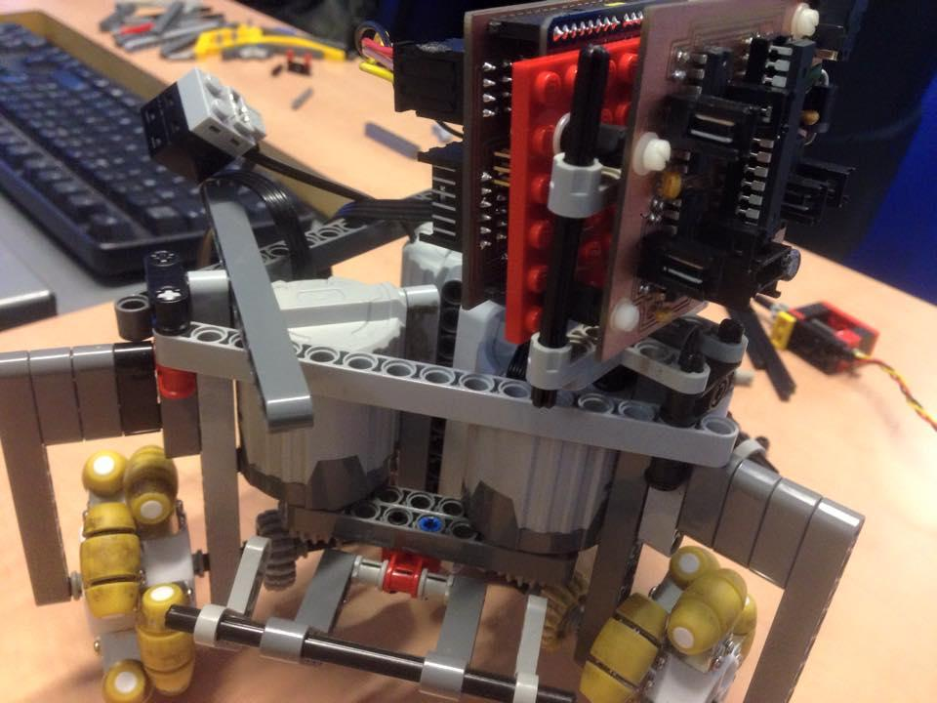
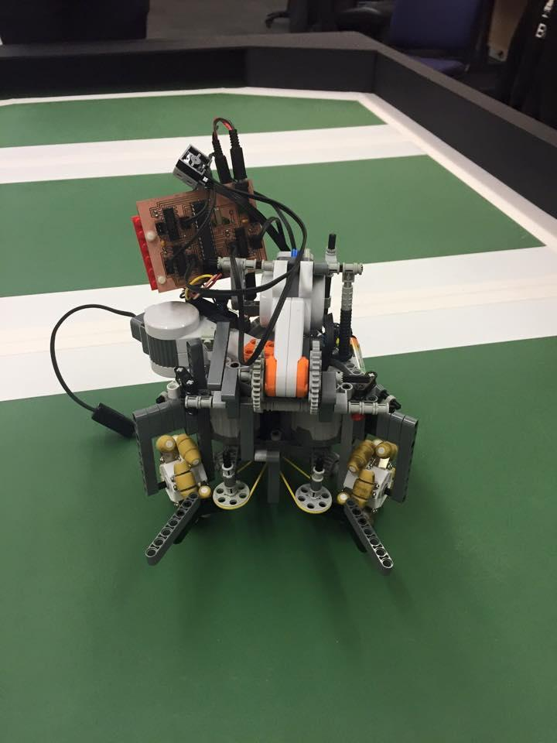
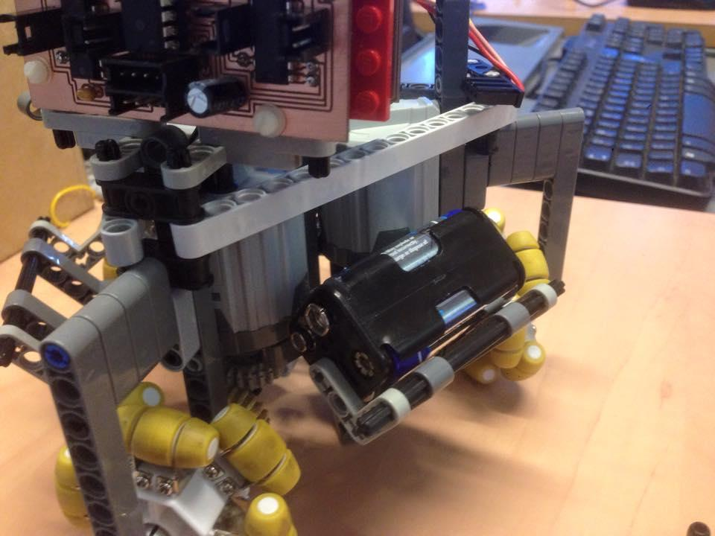
Took off one wheel to make stronger kicker/grabber
Reliably fit in the box
No other good points
Lego doesn't like triangles
Evolution of Margaret “The less wheels the better” era

Slide 9
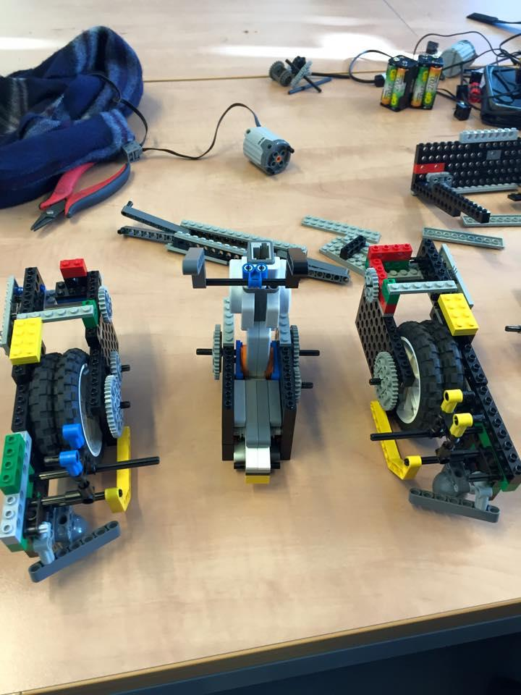
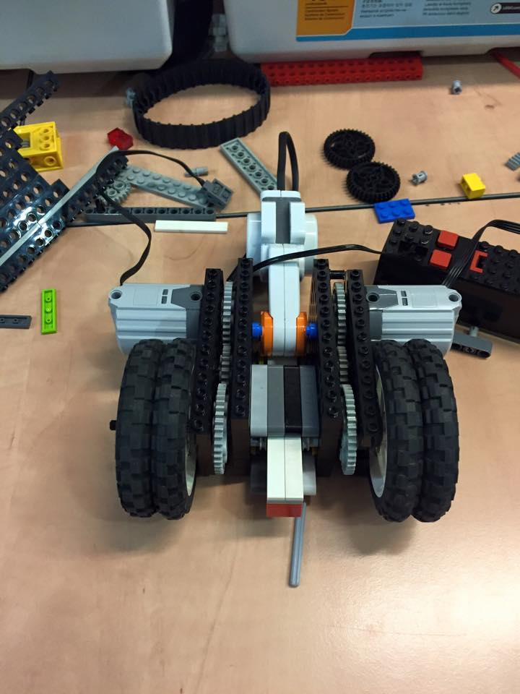
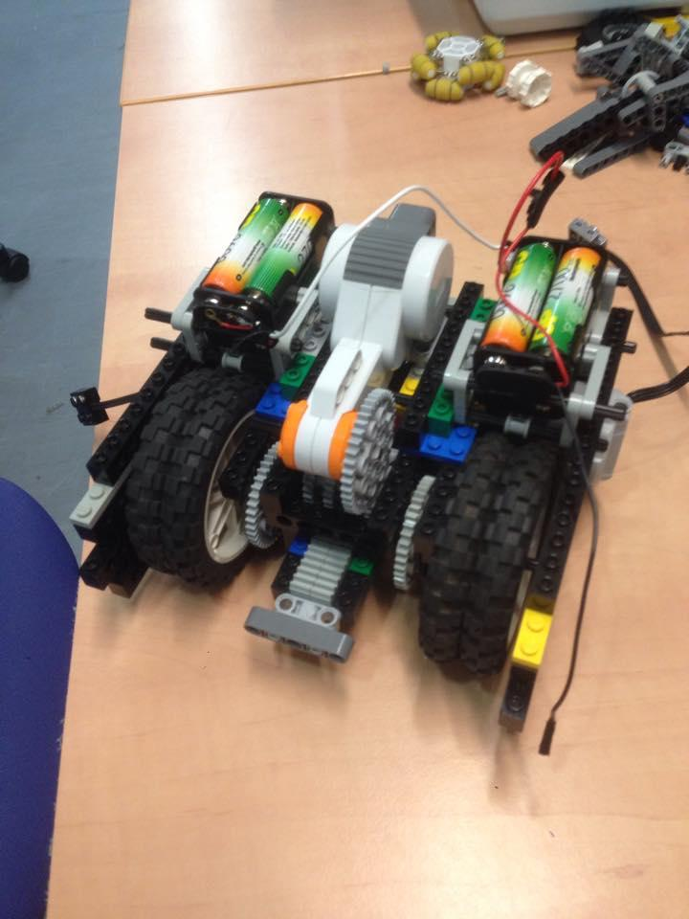
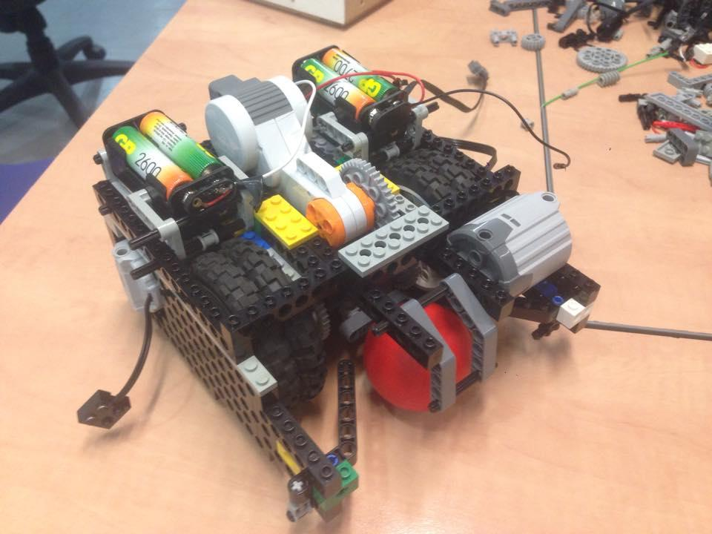
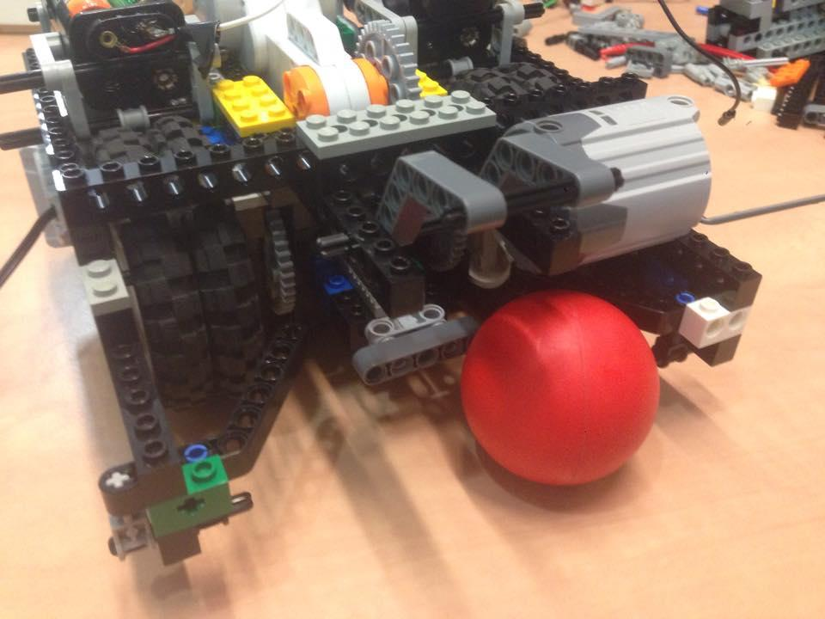
Modular in design (See Pictures)
Space for rotary sensors and encoders
Strong Kicker
Mountable grabbers
Lost degrees of movement.
Evolution of Margaret “The-next-iteration-we-won’t-have-wheels era”

Slide 10
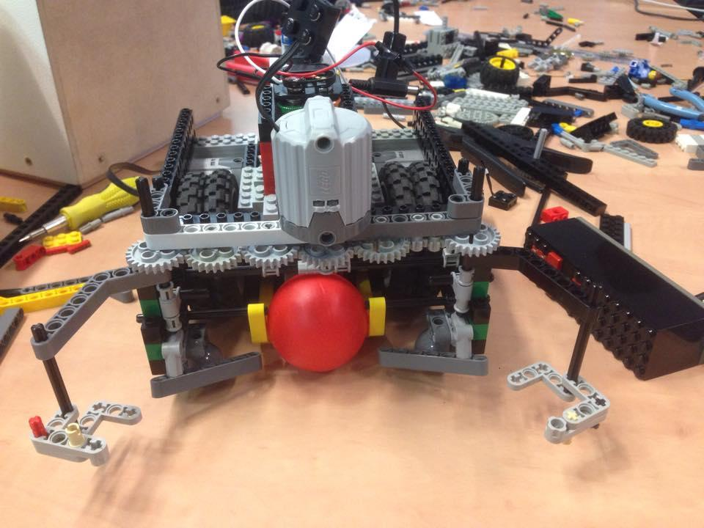
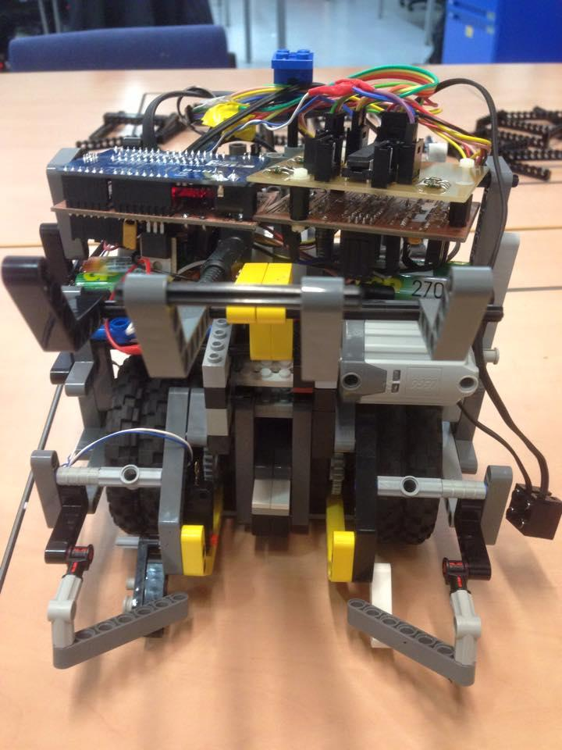
Evolution of Margaret “Super Kicker” Era (Current)

Slide 11
Group 7
Software Changes and USPs

Slide 12
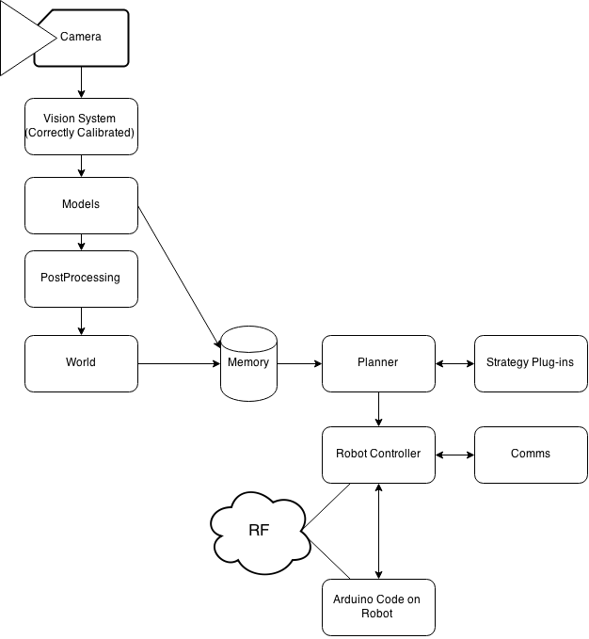
System Architecture (Overall)

Slide 13
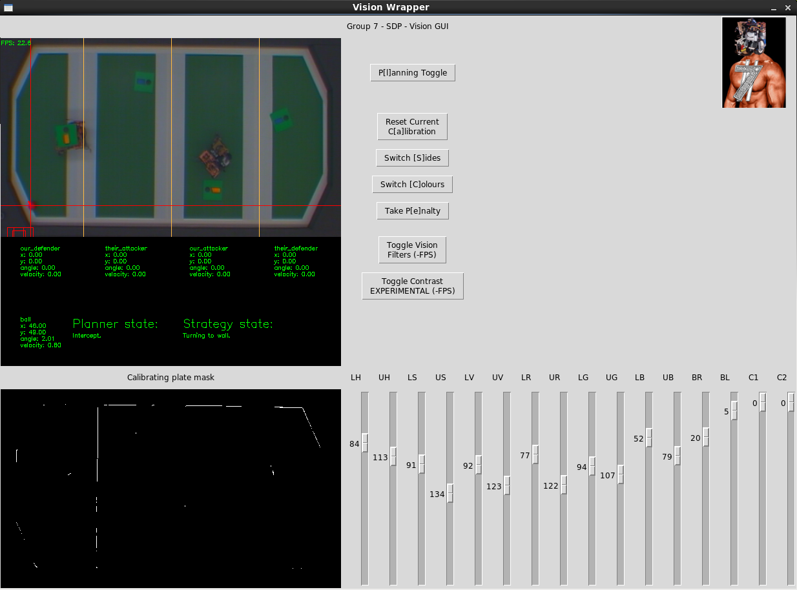
New GUI and additional measured parameters

Slide 14
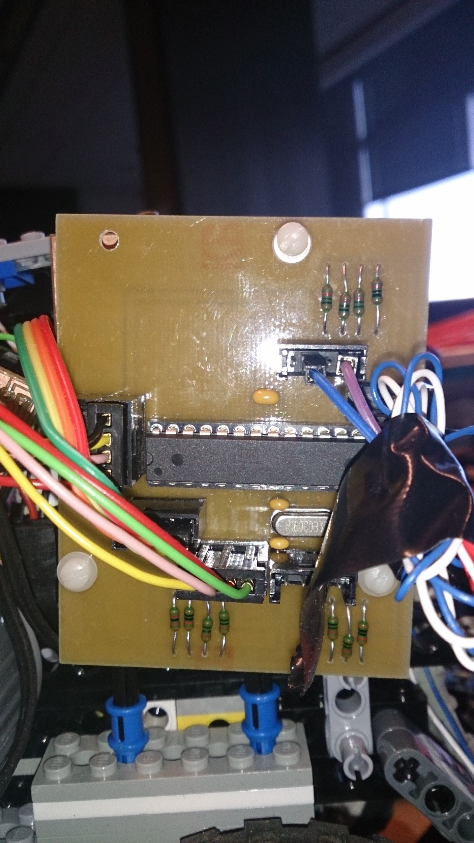
Contribution to SDP
The team has made a contribution to the present and future years of SDP by helping Garry create the new rotary encoder/sensor board, and writing code for it.

Slide 15
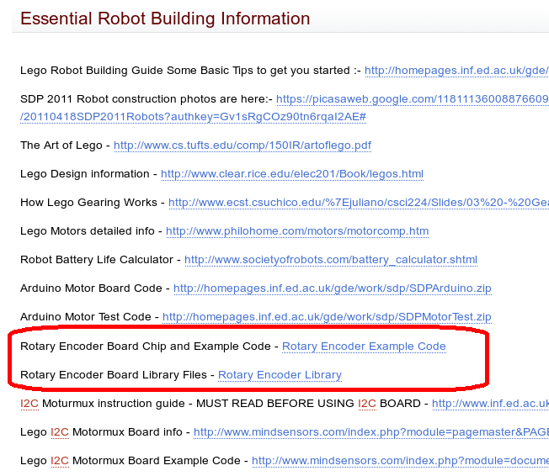

Slide 16
Margaret’s USPs
Our robot has a particularly strong kicker, offline detection of ball in grabber, and ability to accurately move provided distances using proprioception via the rotary sensor.
This allows for scoring off of walls and accurate movement to about 1 cm error per 1m move.

Slide 17

Group 8
Craig Peden
Basile Henry
Akela Drissner
Kostadin Kalinov
Michael Lotkowski
Eugen Alpeza
Andrew Despruce
Botstian Schweinsteiger

Slide 18
Group 8 - Organisation
Flat Hierarchy.
No leader.
No assigned roles, work on what tasks are available.

Slide 19
Group 8
Hardware

Slide 20
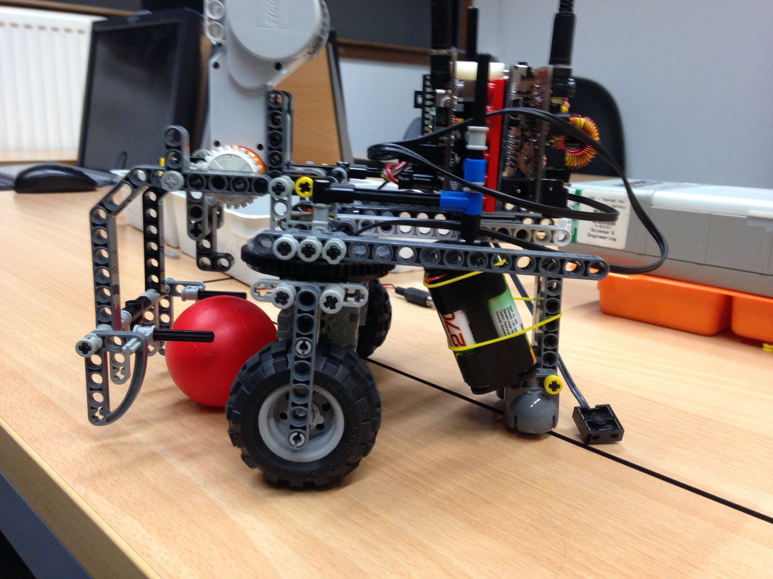
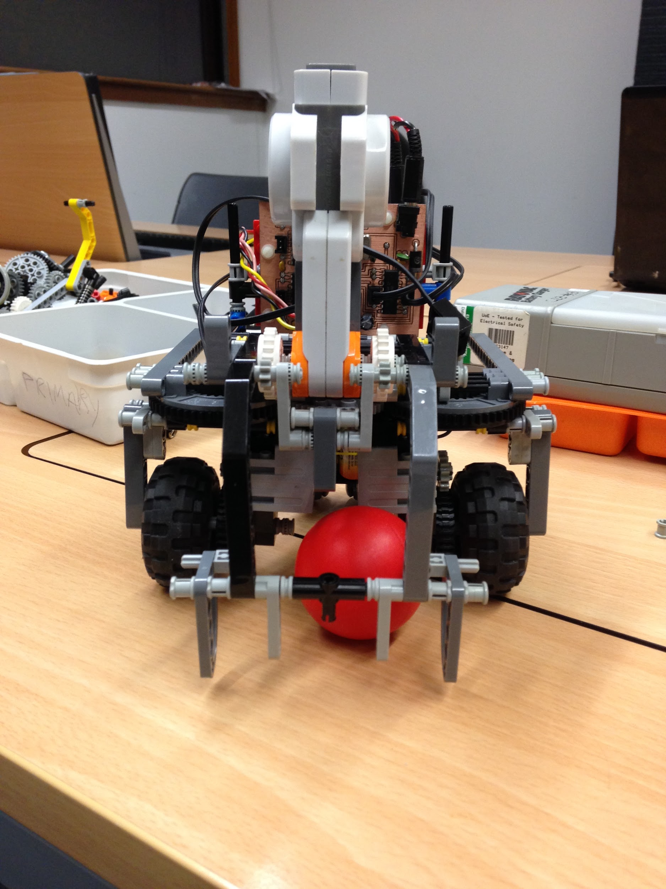
☢ Overcomplicated
☢ Poor Use of Space
Botstian Schweinsteiger, “Nonholonomics” Era

Slide 21
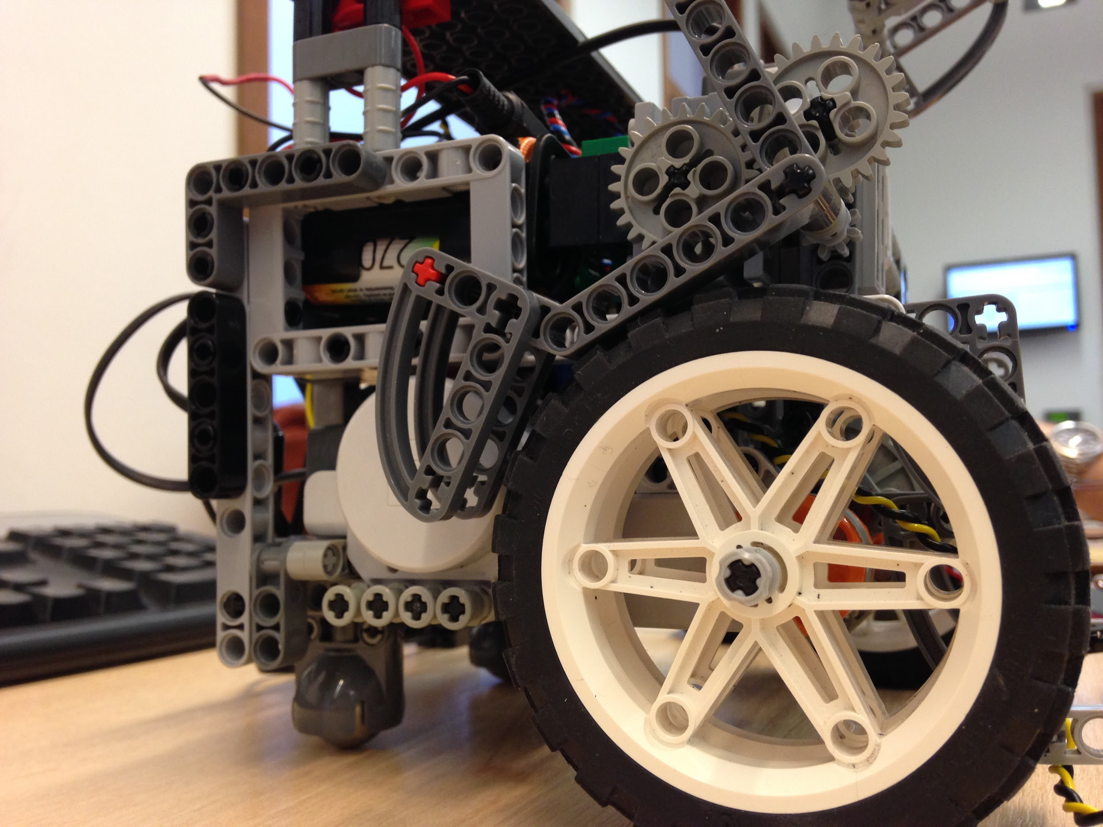
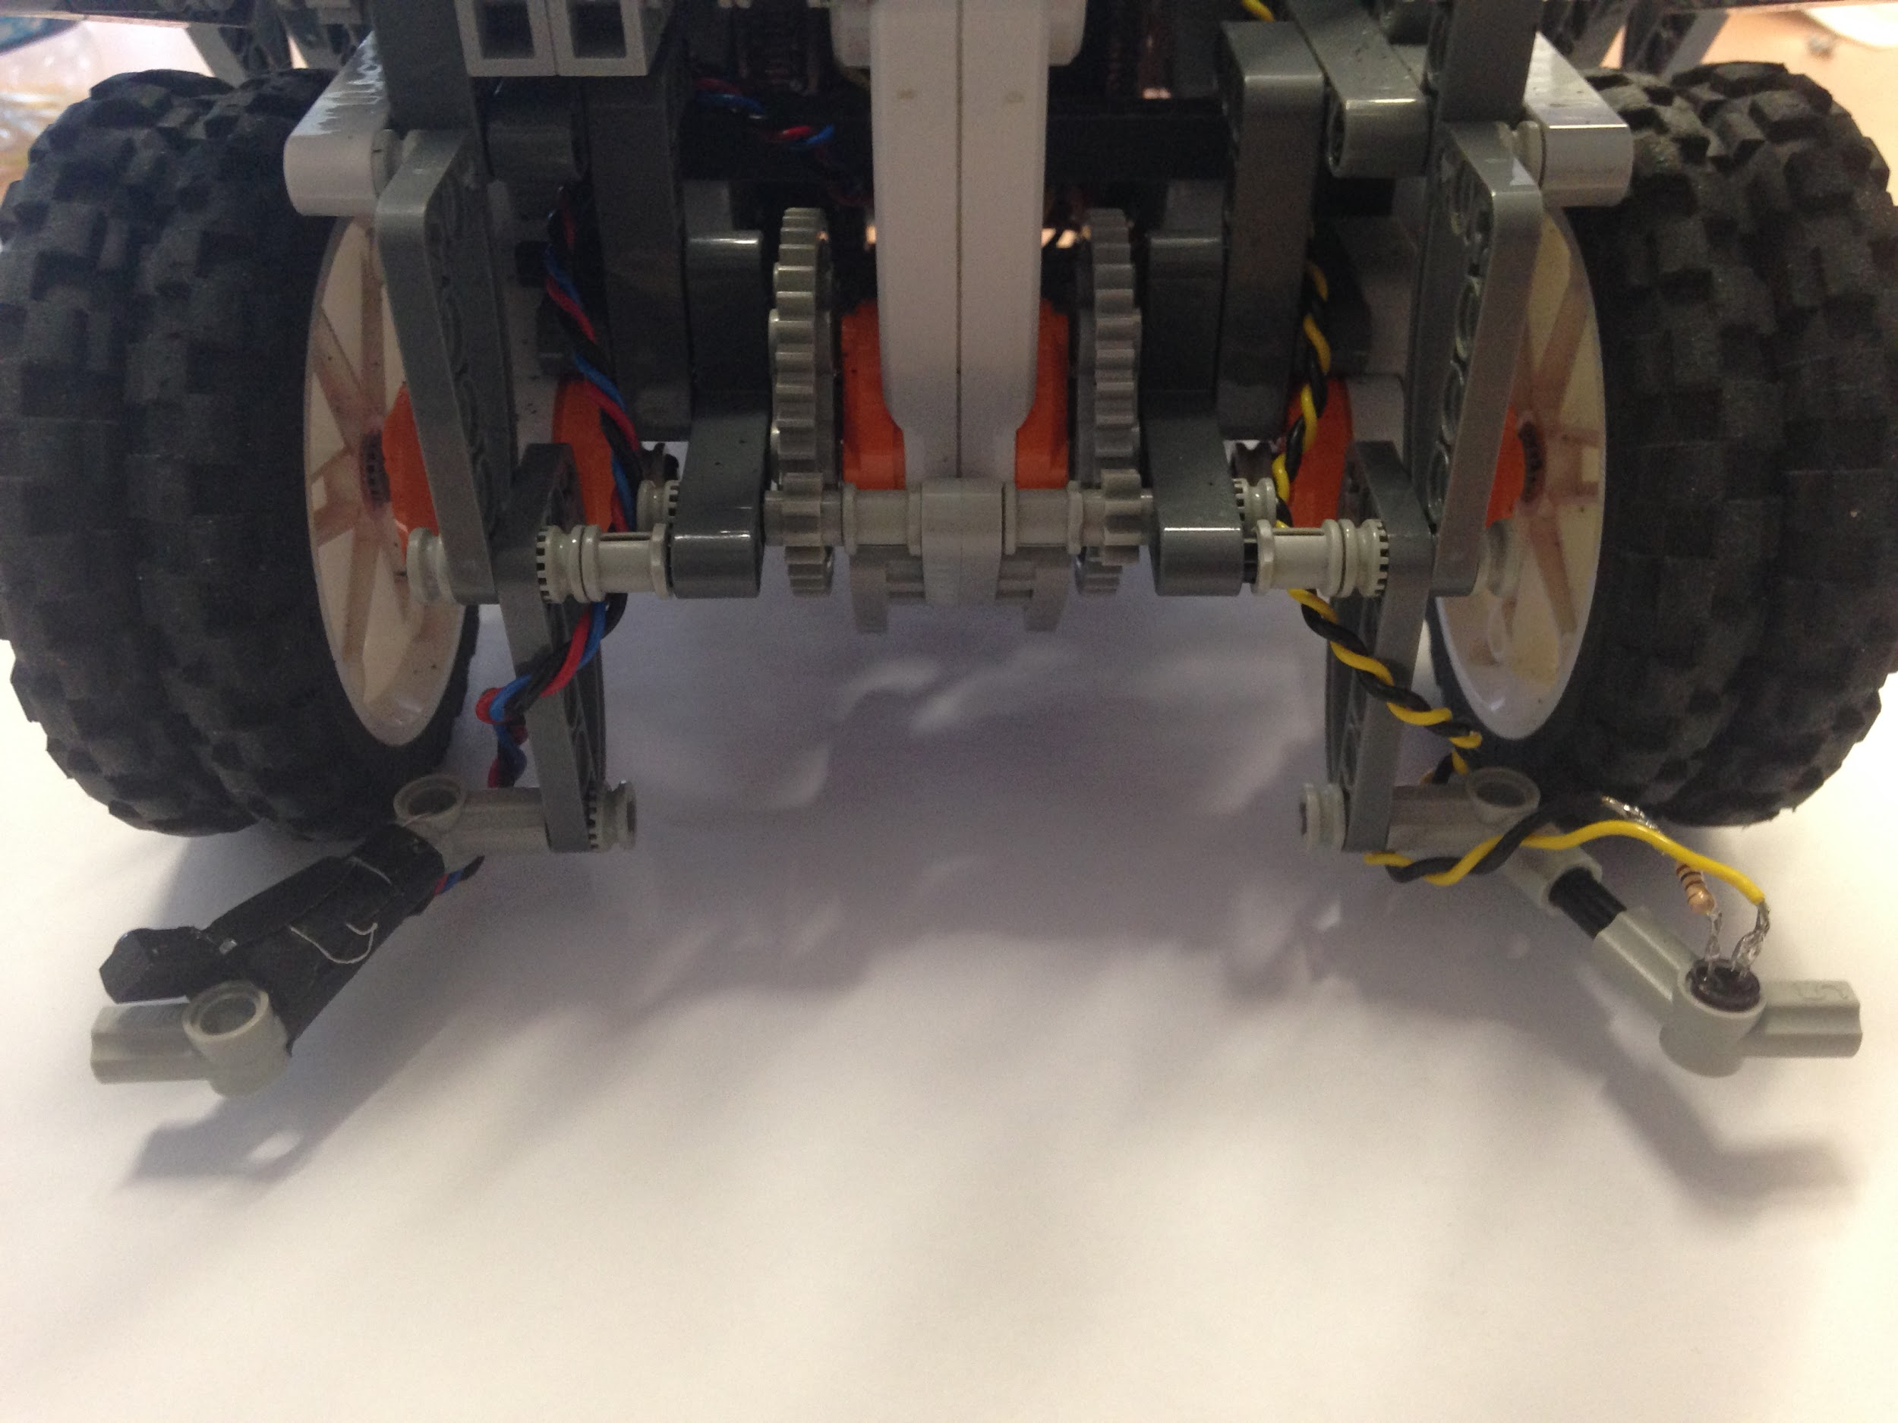
Botstian Schweinsteiger, “Actually Working” Era

Slide 22
Group 8
Software

Slide 23
Group 8 - Architecture
Based on 2014 Group 7, with some changes in three areas:
Planning
Vision
Comms

Slide 24
Group 8 - Planning
Developed an excellent planning logic system, based on a FSM.
Three Distinct Areas of Planning
Prediction
Passing
Reaction
Movement
No own goals
Don’t get stuck on walls
Trespassing
Efficiency

Slide 25
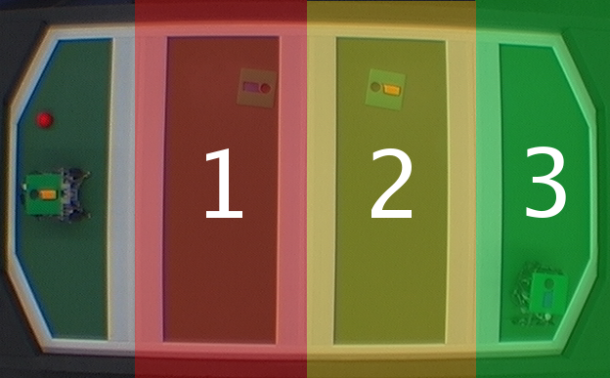
Group 8 - Prediction FSMs
Track ball, then track the attacker if they get the ball
Track ball
Track ball, then track the defender if they get the ball

Slide 26
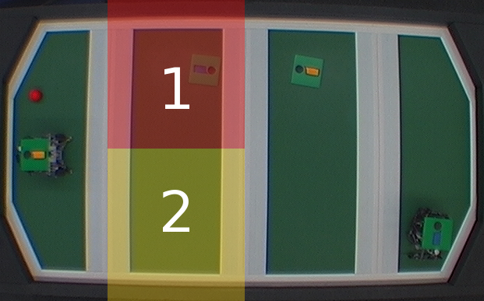
Group 8 - Passing FSMs
If the attacker is in 1, bounce off the wall of sector 2
If the attacker is in 2, bounce off the wall of sector 1
If the attacker is far away, quickly pass to our attacker

Slide 27
Group 8 - Methodology
Instructions - Many Small Commands > One Large
Allows for quick corrections
Input from sensors
Quick changes of strategy
Relative Distances
Fits with our many small commands methodology
Doesn’t require additional hardware
Offline Infrared Sensor
Detects if the ball can be grabbed or is possessed
Allows for ball catching without a vision system

Slide 28
Group 8 - Architecture
Planning
Vision
Comms

Slide 29
Group 8 - Vision
Distortion
Fixed issues with distortion of plates
Better precision in pitch extremities
Normalisation
Smoothing of values over time to mitigate sharp changes in direction that tend to be errors
Vision Equalization
Samples pixel groups in sectors of each Zone to help manage lighting gradient over pitch.

Slide 30
Group 8 - Architecture
Planning
Vision
Comms

Slide 31
Group 8 - Communication
Multi Threading
Instructions come from planning and infrared sensor
Custom Protocol
Every command and arguments fit in a single byte
Checksum
Decision Making Online and Offline
Offline decisions passed back to the system
Arduino handles catching, not the vision system

Slide 32
Group 8
Teamwork

Slide 33
7 + 8 = E
Robots mostly individual, with some limited inter-team discussion over design aspects.
Main area of co-ordination was joint strategies for passing.

Slide 34
Things we learned
Things Fall Apart
If it can break. It will. Usually during a match.
Managing people isn’t trivial.
Groups are hard.
Robots have a mind of their own.
They really love walls. A lot.

Slide 35
Questions?

